Slide 1
Lecture 14
Edmonds-Karp Algorithm

Slide 2
Edmonds-Karp Algorithm
The augmenting path is a shortest path from s to t in the residual graph (here, we count the number of edges for the shortest path).

Slide 3
Ford-Fulkerson Max Flow
4
2
5
3
1
1
1
2
2
s
4
t
3
2
1
3
This is the original network.

Slide 4
Ford-Fulkerson Max Flow
4
2
5
3
1
1
1
2
2
s
4
t
3
2
1
3
Choose a shortest path from s to t.

Slide 5
Ford-Fulkerson Max Flow
4
2
5
3
1
1
1
2
2
s
4
t
3
2
1
3
This is residual graph after the 1st augmentation.

Slide 6
Ford-Fulkerson Max Flow
4
2
5
3
1
1
1
2
2
s
4
t
3
2
1
3
Choose a shortest path from s to t.

Slide 7
Ford-Fulkerson Max Flow
4
2
5
3
1
1
1
2
2
s
4
t
1
1
2
2
3
The residual graph after the 2nd augmentation.

Slide 8
Ford-Fulkerson Max Flow
4
2
5
3
1
1
1
2
2
s
4
t
1
1
2
2
3
Choose a shortest path from s to t.

Slide 9
Ford-Fulkerson Max Flow
3
2
5
1
2
1
1
1
1
2
2
s
4
t
1
1
2
2
3
The residual graph after the 3rd augmentation.

Slide 10
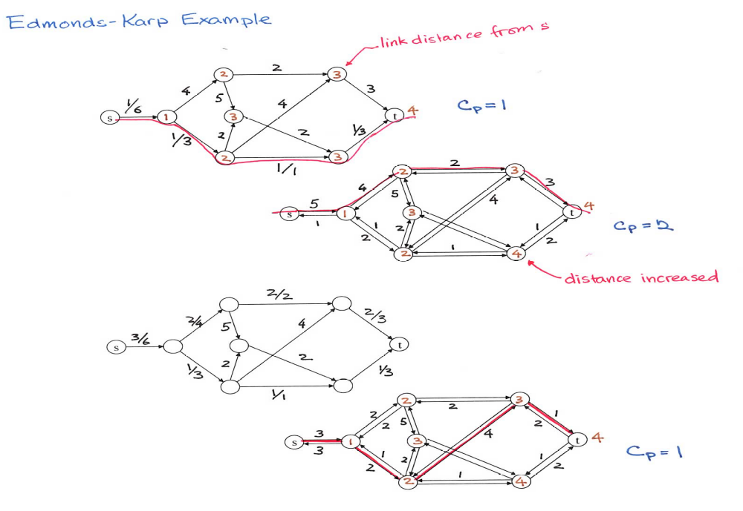
Edmonds-Karp Algorithm
3

Slide 11
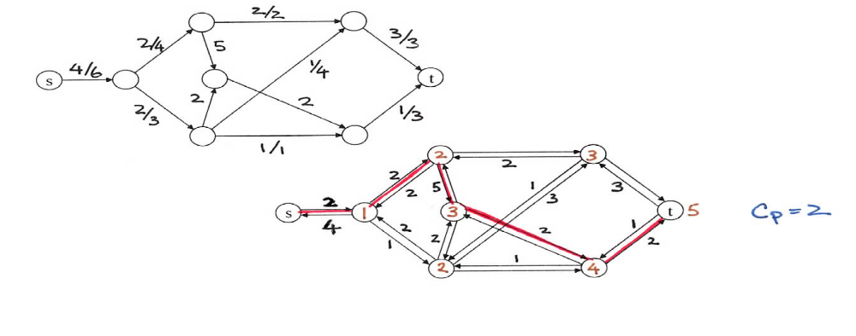
Edmonds-Karp Algorithm
3

Slide 12
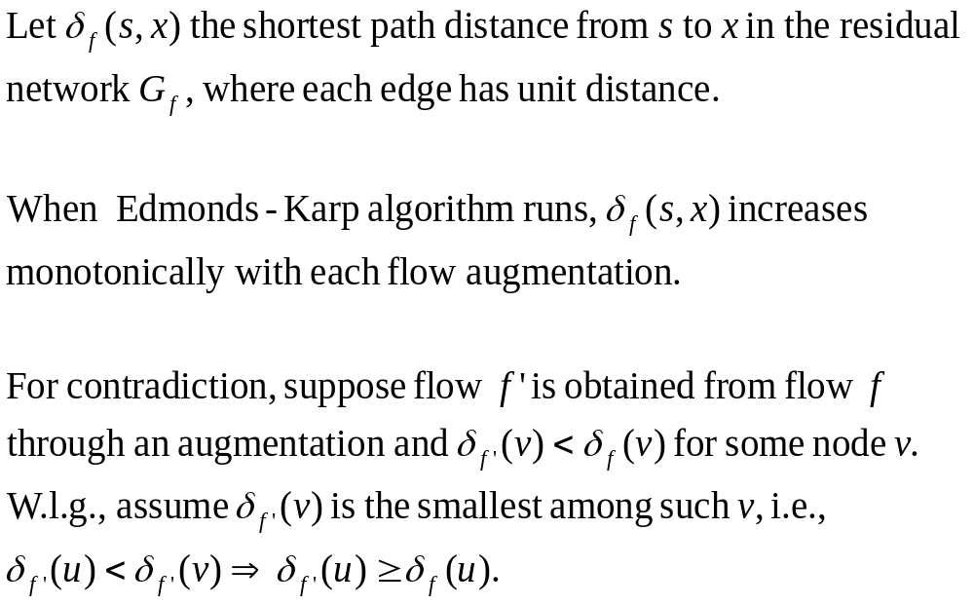

Lemma
Proof

Slide 13
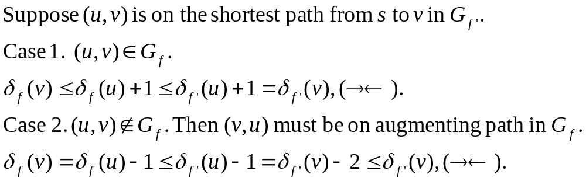






Slide 14
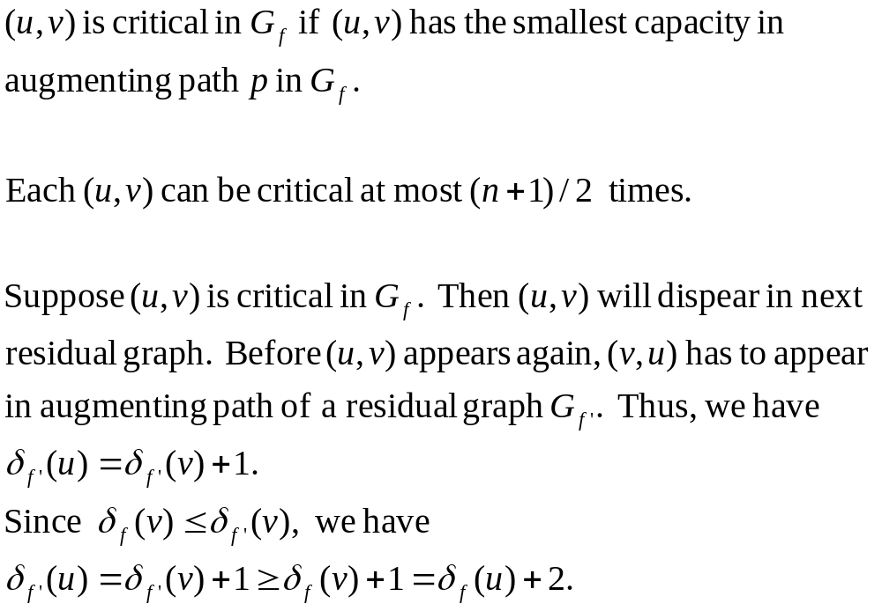
Lemma
Proof

Slide 15
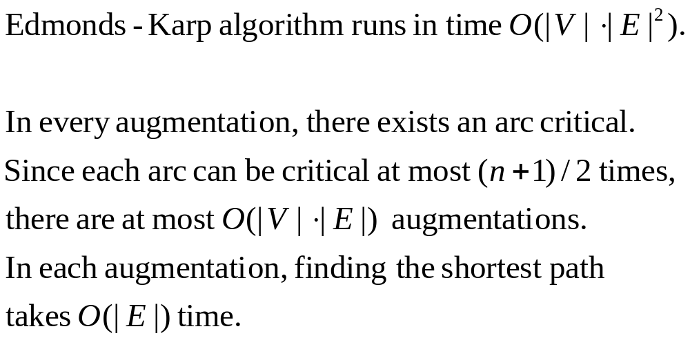
Theorem
Proof

Slide 16
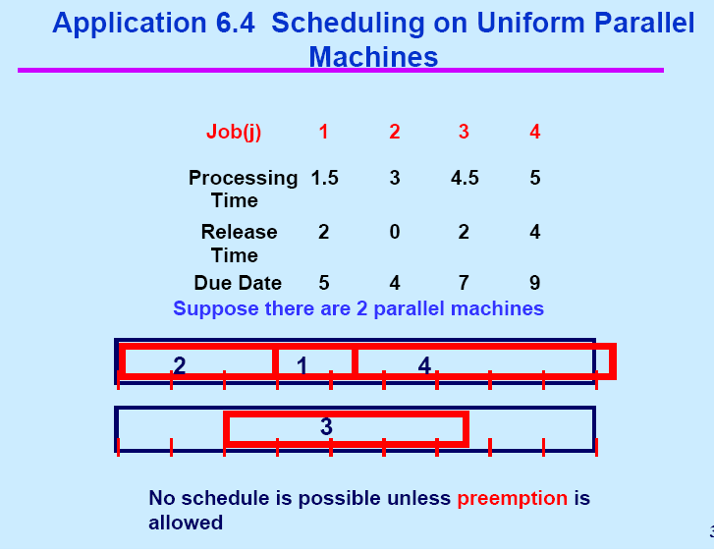

Slide 17
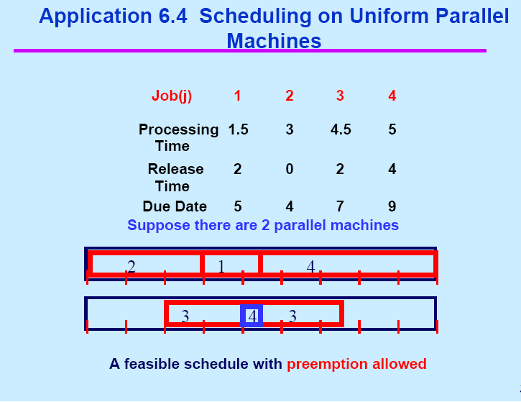

Slide 18
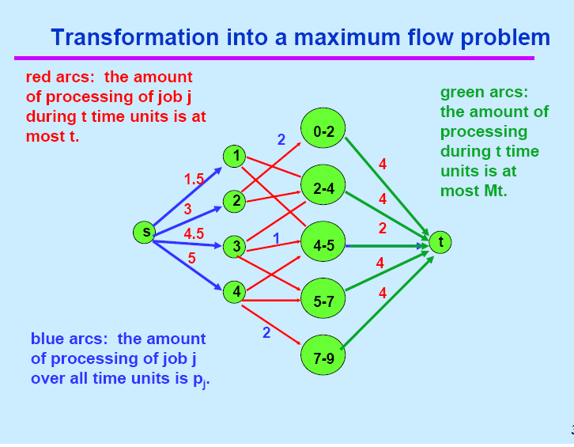

Slide 19
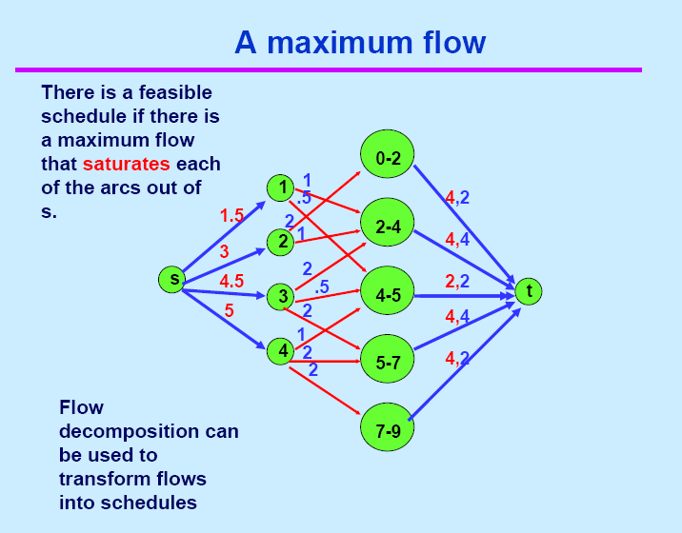

Slide 20
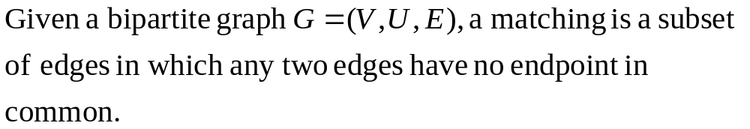
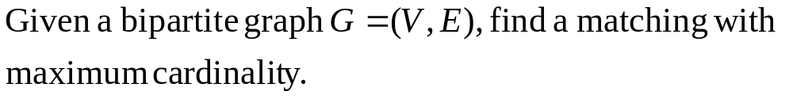
Matching in Bipartite Graph
Maximum Matching

Slide 21
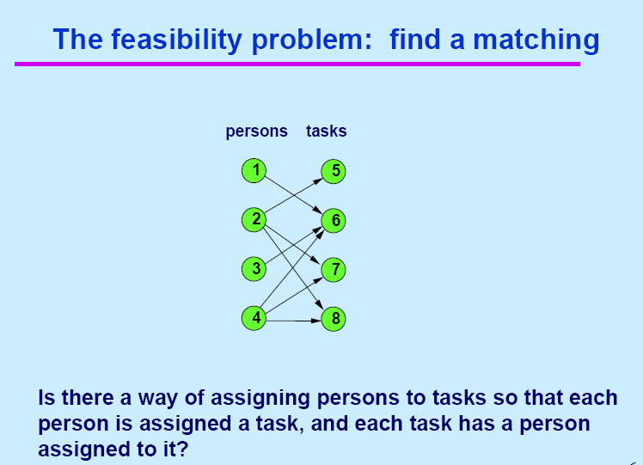

Slide 22
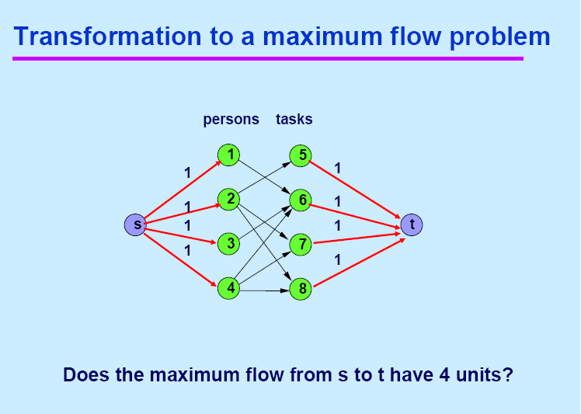
1
1

Slide 23
Note: Every edge has capacity 1.

Slide 32
1. Can we do augmentation directly
in bipartite graph?
2. Can we do those augmentation
in the same time?

